Slide 1


Applying graph theory measures for analyzing networks in brain recordings
Capstone Project Phase B
Students:
Koral Pnina Biton
Topaz Eldori
Supervisor:
Dr. Anat Dahan
Project Code:
24-1-R-6

Slide 2
Table Of Content
01
01
Problem & Solution
02
The Process
The Process
03
Results & demonstration
Problem & Solution
Challenges
04
Challenges
Results & demonstration

Slide 3

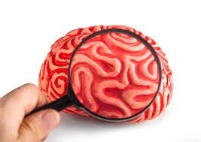
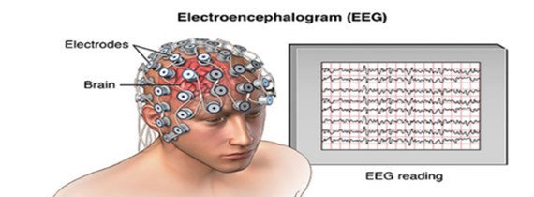
The Problem
ADHD is one of the most common disorders, especially among children.
Without processing, EEG files alone provide little information about brain connectivity and function.
Few tools that allow analysis of EEG recordings that provides community detection and graph measures

Slide 4
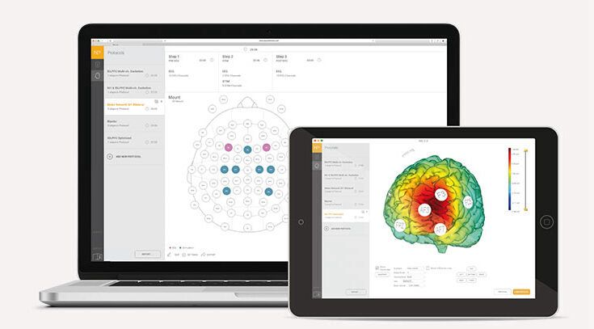
Our solution
Brain Recordings Analysis System
01
Converting EEG recordings to graphs for data analysis.
03
Individual and group analysis.
02
04
Exporting data results of a group and patients to Excel in order to enable statistical tests in the future
using community detection algorithms and calculating various graph measures
Notes:
The data from EEG brain recordings consists of electrical signals that are difficult to interpret without specialized analysis

Slide 5
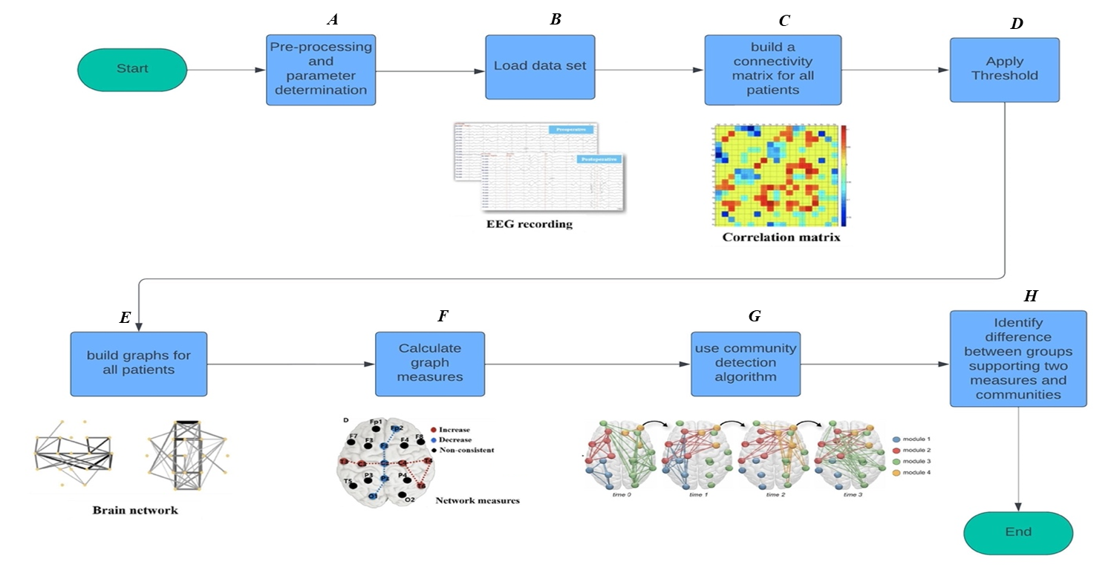
The Process

Slide 6
Pre-processing and parameter determination
A
Converted MATLAB EEG recording files to Excel format for easier access.
Applied techniques to remove noise from the recordings, such as eye blinks and muscle movements, to ensure the data is as clean as possible for more accurate analysis.

Slide 7
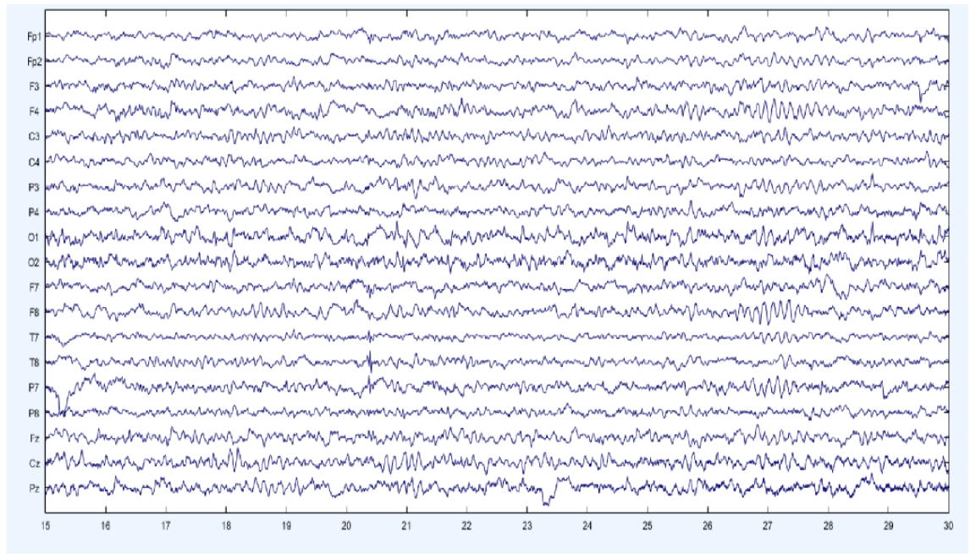

Load data set
B
Our dataset consists of 61 children with ADHD and 60 typically developing children aged between 7 and 12, encompassing both genders. The EEG recordings were conducted utilizing 19 channels at a frequency of 128 Hz.
In the task, a set of pictures of cartoon characters was shown to the children and they were asked to count the characters.
The number of characters in each image was randomly selected between 5 and 16.

Slide 8
Load data set
B
After cleaning the data, we consulted with our supervisor, Dr. Anat, and decided to segment the recordings.
This segmentation allows for detailed analysis of EEG data by examining brain activity in smaller time frames, which is crucial as cognitive load and brain activity can change during tasks.
A previous study using the same dataset divided each patient's time series into 8 second segments. Following this research, we implemented the same 8 second segmentation in our code, ensuring consistency with the prior work.

Slide 9
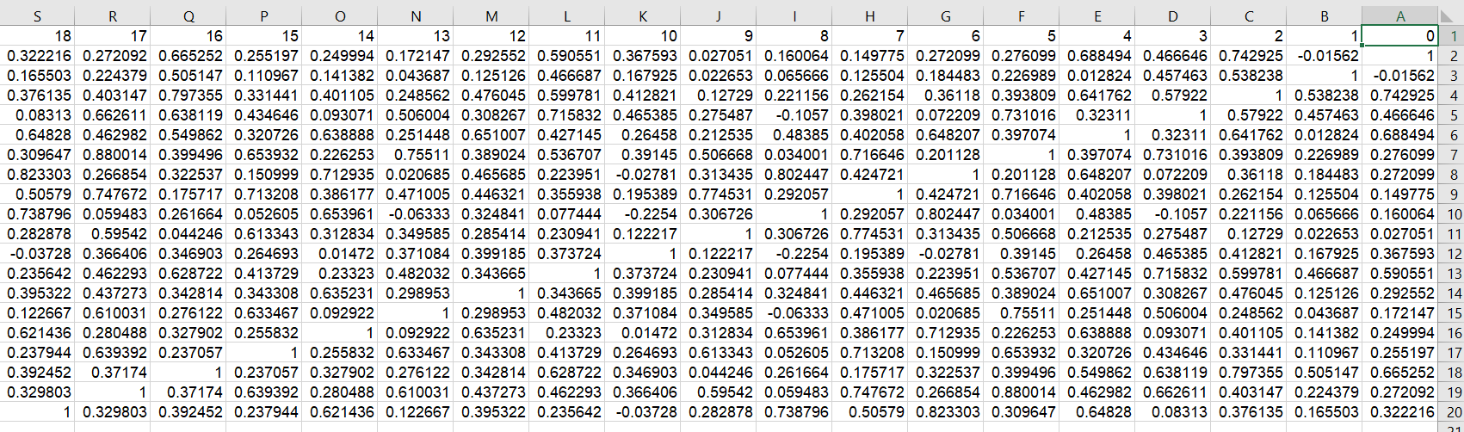
Build connectivity matrix for all patients
C
For each patient, after dividing his brain recording into 8 second segments, we built a 19x19 connectivity matrix calculated by the Pearson correlation coefficient.
We chose to utilize the Pearson’s correlation coefficient, which is the most widely used technique to determine the correlation of signals between a pair of nodes.

Slide 10
Apply Threshold
D
After an in-depth investigation of various possible thresholds and consultation with Dr. Anat Dahan, our supervisor, and decided that an absolute threshold would be appropriate for our analysis. The threshold values we selected range from 0.4 to 0.7.
Thresholding simplifies the network by focusing on the most significant connections, and this range was chosen based on related work using similar EEG data.
This approach helps to highlight the most critical aspects of brain connectivity that may be relevant to differentiating between ADHD and Non-ADHD groups.

Slide 11
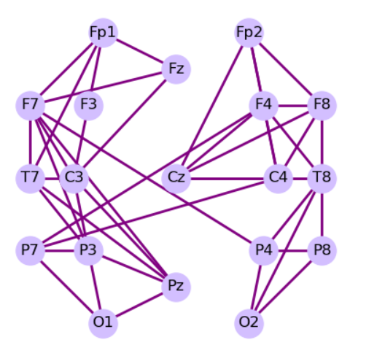
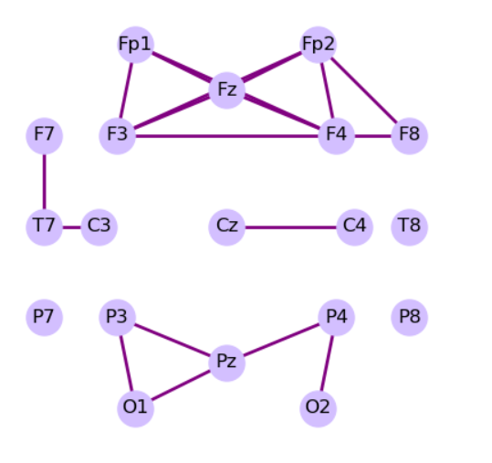
Build graphs for all patients
E
After selecting and applying the threshold, we constructed a graph for all the segments of each patient. In this graph, the nodes represent the locations of the electrodes, and the edges indicate the functional connectivity between these locations
We then presented the graph based on the 10-20 standard using 19 channels. The 10-20 system, is a globally accepted method for describing and positioning scalp electrodes during an EEG examination.
Non-ADHD
ADHD

Slide 12
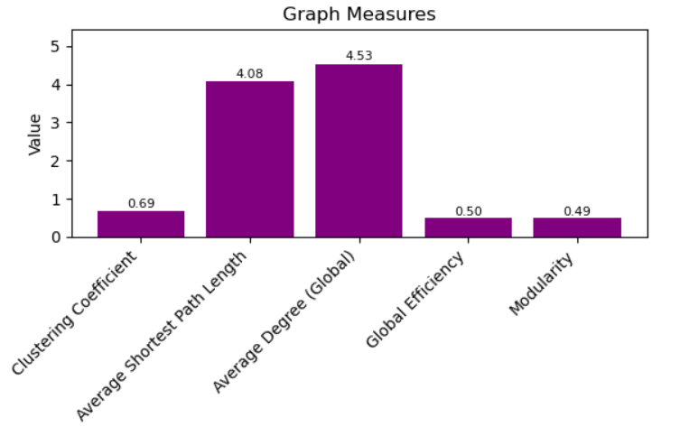
Calculate graph measures
F
We chose to use the following measures to reach appropriate insights for the study:
Global Efficiency, Clustering Coefficient ,Average Degree, Modularity and Average shortest path length
We chose these measures because they provide insights into the structure and function of brain connectivity networks.
The measures were calculated for all segments of each patient.

Slide 13
Calculate graph measures
F
Global efficiency: This measure how efficiently information can be transmitted across the entire network. It's the average of the shortest path lengths between all pairs of nodes.
Clustering Coefficient: The average of the local clustering coefficients (the local clustering coefficient of a node measures how close its neighbors are to being a complete graph.) of all nodes, indicating how clustered the network
Average Degree: This is the average number of connections each node has in the network.

Slide 14
Calculate graph measures
F
Modularity: This measure shows how well the network can be divided into distinct communities or modules. It's determined based on a pre-defined community structure and reflects the quality of such division.
Average shortest path length: This measure is defined as the average number of steps along the shortest paths for all possible pairs of network nodes. It is a measure of the efficiency of information or mass transport on a network.

Slide 15
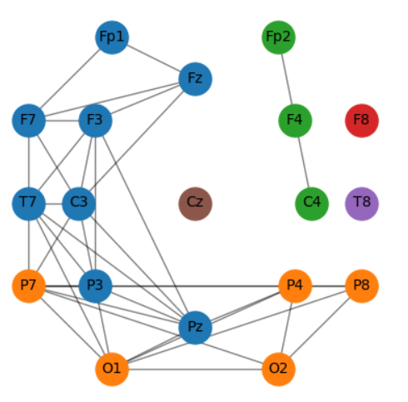
Use community detection algorithm
G
Fast Greedy
We chose to use in fast greedy algorithm.
The algorithm presents an efficient method for identifying communities within networks by maximizing modularity.
By applying this algorithm to each segment for every patient, we calculate the communities within the brain network, and then present these communities visually in the graph for each segment during the task, both for ADHD and non-ADHD patients.

Slide 16
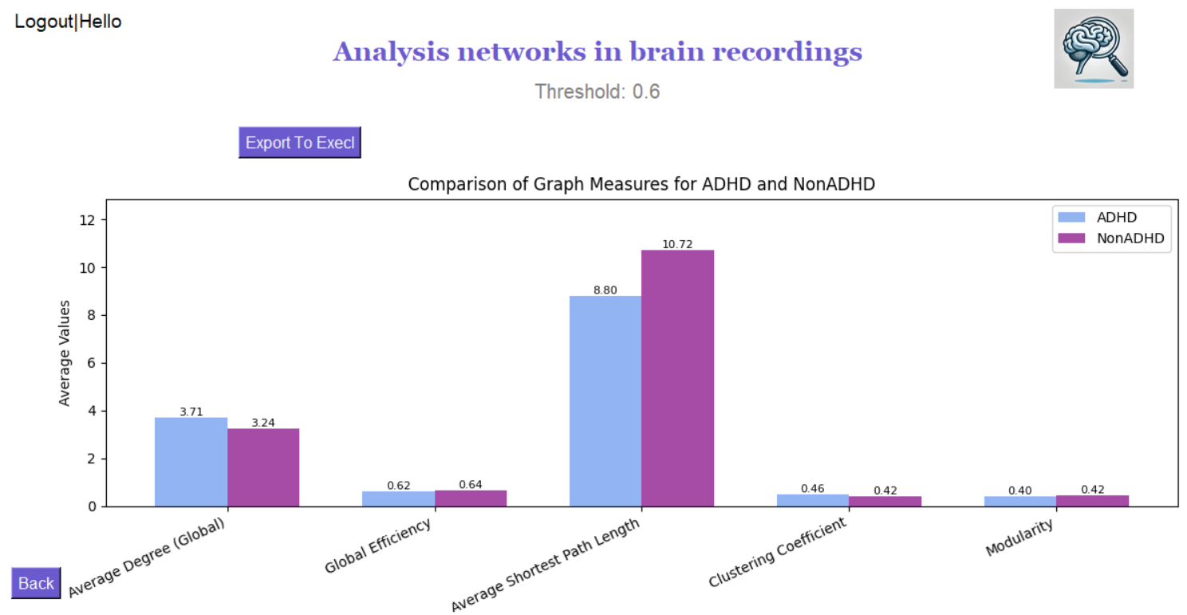

Identifying differences between groups
H
We are interested in understanding the differences between the ADHD and control groups. we calculated the average of the measures for the two groups, the ADHD group and the control group.

Slide 17
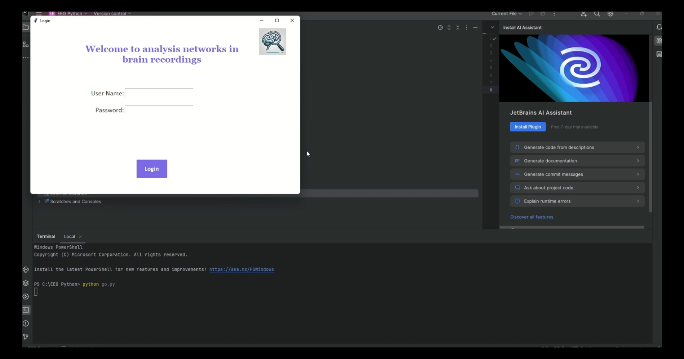
demonstration

Slide 18
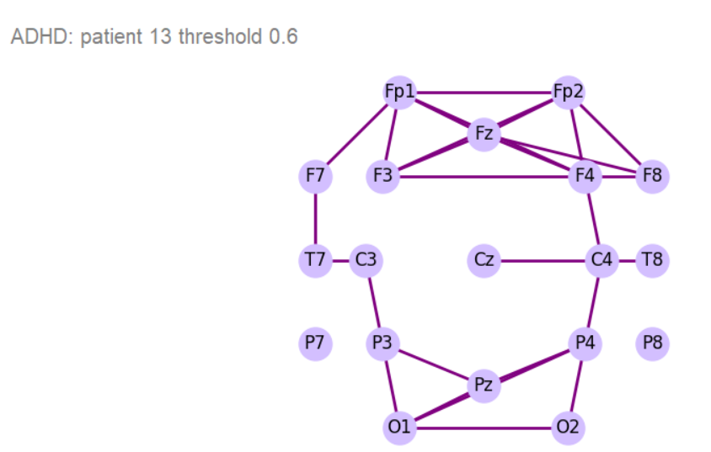
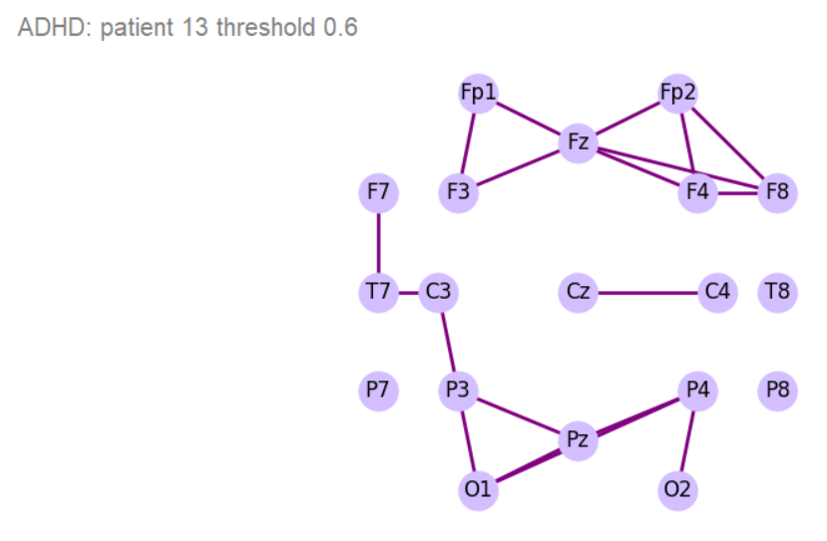
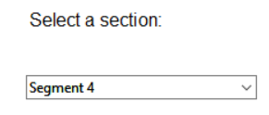
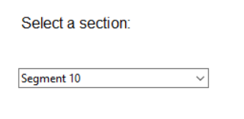
Results
We will show an example using one patient with ADHD and one without ADHD. We will examine different segments during the task and explain what the graphs reveal

Slide 19
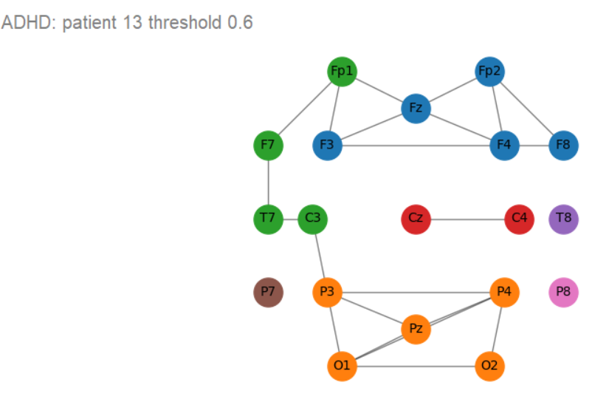
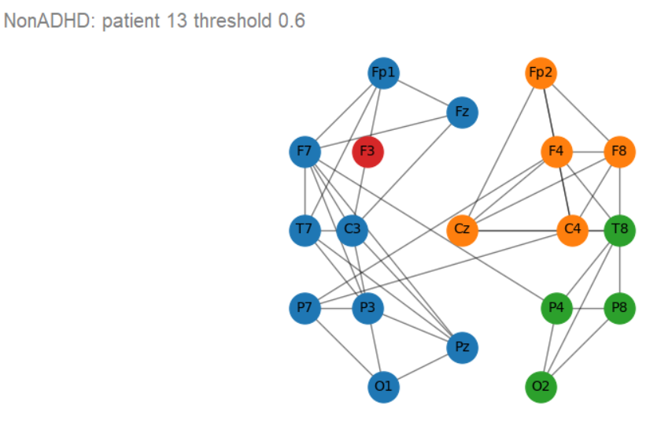
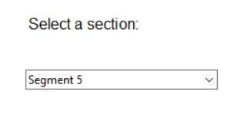
Results
The screenshots illustrate the results of community detection in the brain networks of a Non-ADHD patient and an ADHD patient using a fast greedy algorithm.
The Non-ADHD patient shows multiple well-connected communities, indicating structured and efficient brain function. In contrast, the ADHD patient has fewer and more fragmented communities, suggesting reduced coordination between brain regions.

Slide 20
Results
At first look, it can be seen that the average degree in the ADHD group is higher which can indicate that their brain networks may be more locally connected which may result in a shorter path length.
Non-ADHD group displays higher global efficiency, which can indicate that their brain networks are better adapted for faster and more efficient communication between different brain areas.

Slide 21
Results
It is important to note that we cant yet determine if these differences are statistically significant, as no statistical tests have been performed.
A feature has been added to allow the data to be exported to Excel files, enabling future statistical tests to be conducted.

Slide 22

Challenges
Dataset Noise: Initially, we encountered significant noise in the EEG signals. It was challenging because we had to learn new methods and understand how to clean the data.
Threshold Selection: Selecting an appropriate threshold for brain network analysis was challenging. After testing various thresholds, we decided on a range between 0.4 and 0.7 to preserve meaningful connections, following consultation with our supervisor.

Slide 23
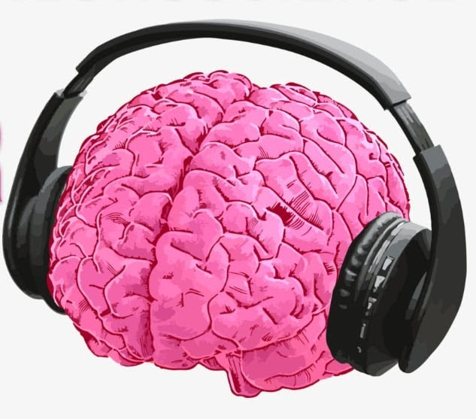
Thanks for Listening

